Slide 1
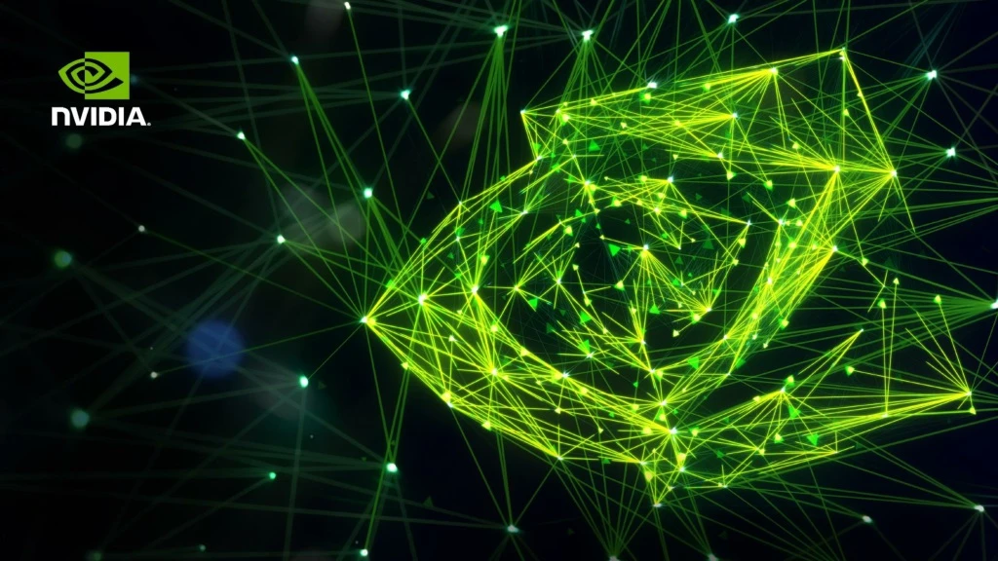


CASE STUDY
of
Presented By-
Suyash Kadu & Manjeet Gupta

Slide 2
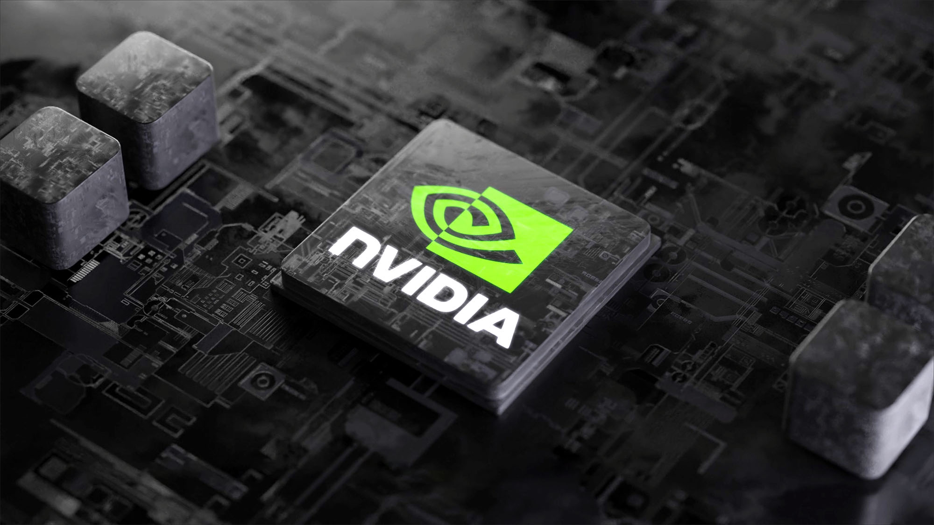
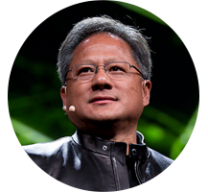
COMPANY OVERVIEW
Founded: 1993 by Jensen Huang, Chris Malachowsky, and Curtis Priem
Headquarters: Santa Clara, California, USA
CEO: Jensen Huang (co-founder and still leading)
Core Business:
GPUs (Graphics Processing Units) → GeForce for gaming, RTX for creators, Quadro for professionals
Data Centers & AI → Powerful GPUs (A100, H100) used in AI training, cloud computing, and supercomputers
Automotive → NVIDIA DRIVE platform for self-driving cars and in-vehicle systems
Omniverse & Digital Twins → Virtual worlds, simulations, and metaverse platforms

Slide 3


Year - 1995
“Only 30 days until bankruptcy”
Year - 2025

Slide 4
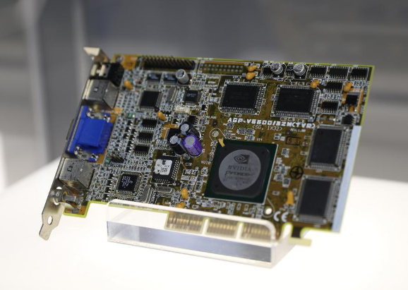
NVIDIA NV1 CHIP
Units Sold – 250,000
Units Return – 249,000
Total Loss – 1 Millon $

Slide 5
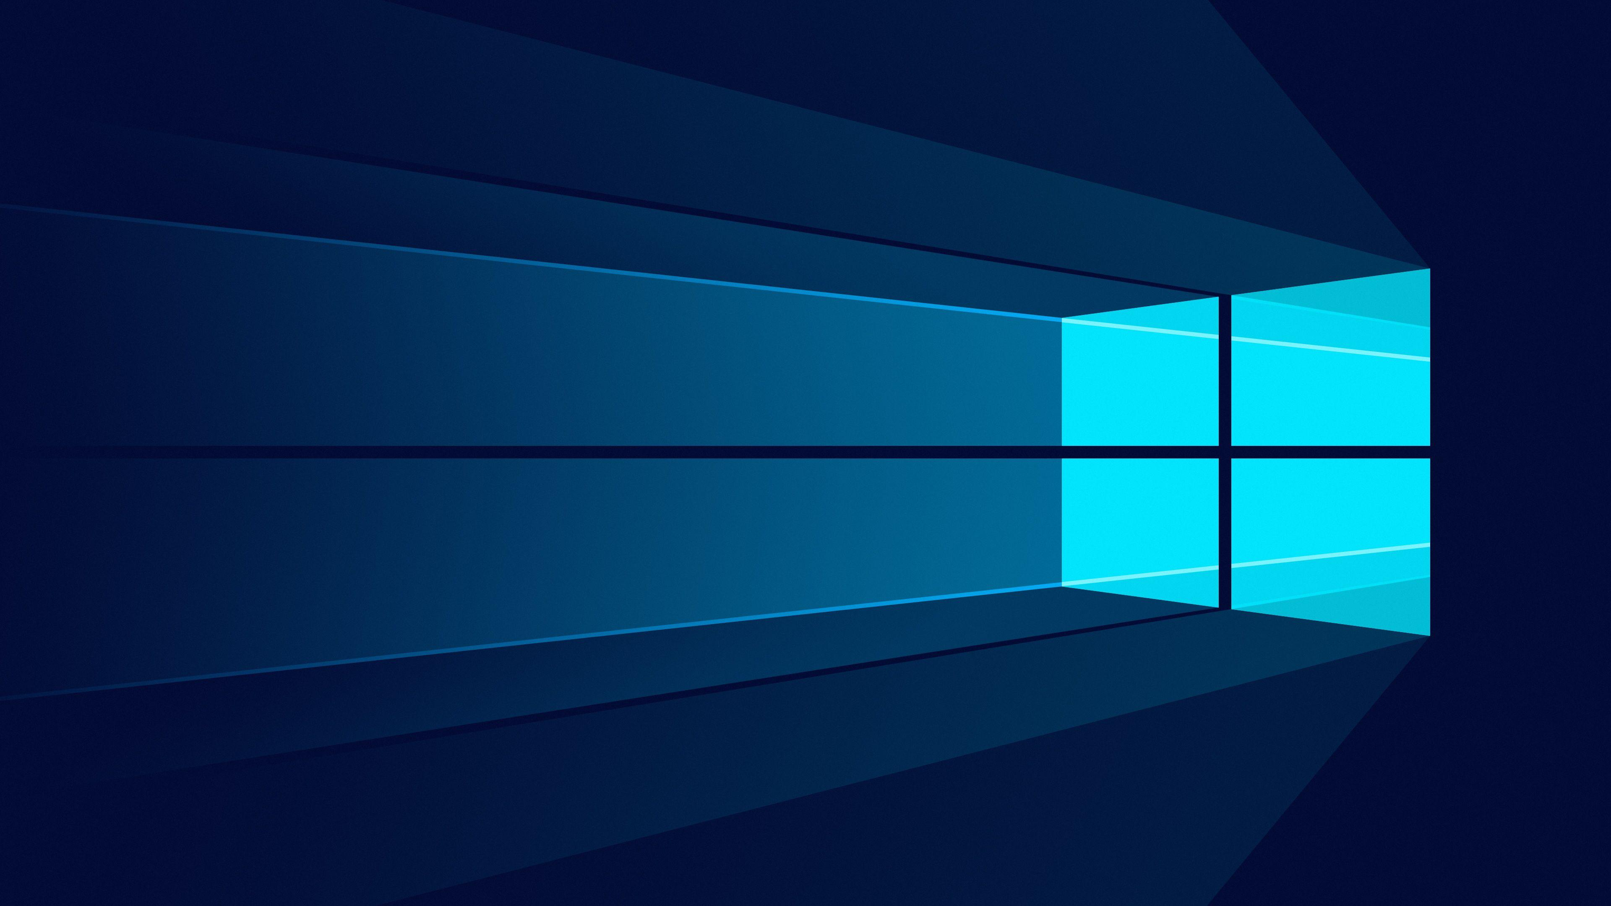

MICROSOFT

Slide 6
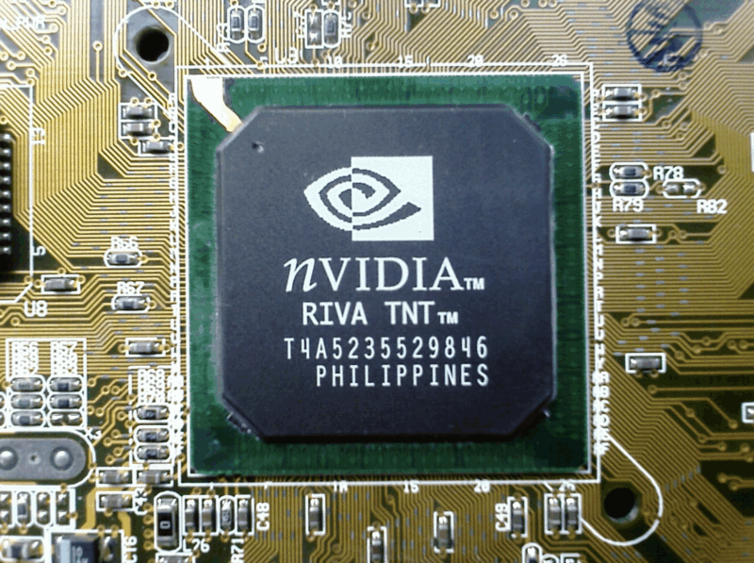
NVIDIA RIVA CHIP

Slide 7
Case Study of NVIDIA
THANK YOU
Presented By-
Suyash Kadu & Manjeet Gupta

